Slide 1
USER AGENTS
Anomaly Detection
Olumide Karim-Mohammed

Slide 2
What?
Provided with approx. 1.5 million records of web gateway logs
Logs were capture on 2nd of Aug 2011 between 10 to 11:30PM
Logs contain user agent strings which are client side editable parameters that enable webservers better respond to clients’ requests.
Typical information provided by user agent strings include:
Browser type and version
Operating system and version
Device information
etc

Slide 3
Still on The What..
Wrangle the data into a usable format
Then look into creating an anomaly detection model that can spot any unusual pattern in the activities captured.
Surface this model via an API that can potentially be used to assess new cases

Slide 4
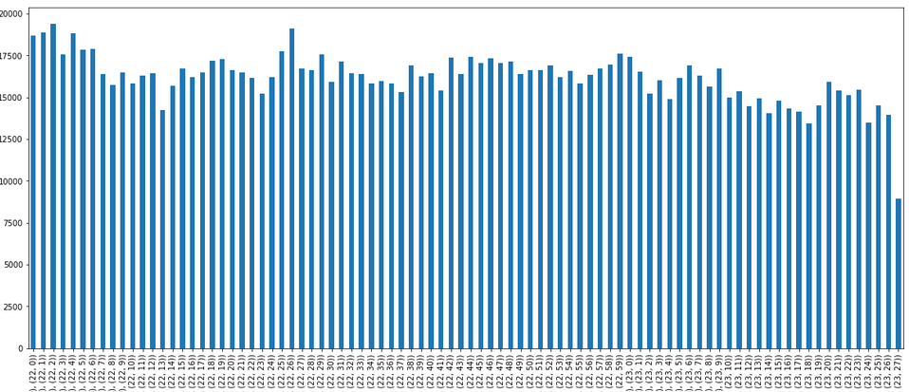
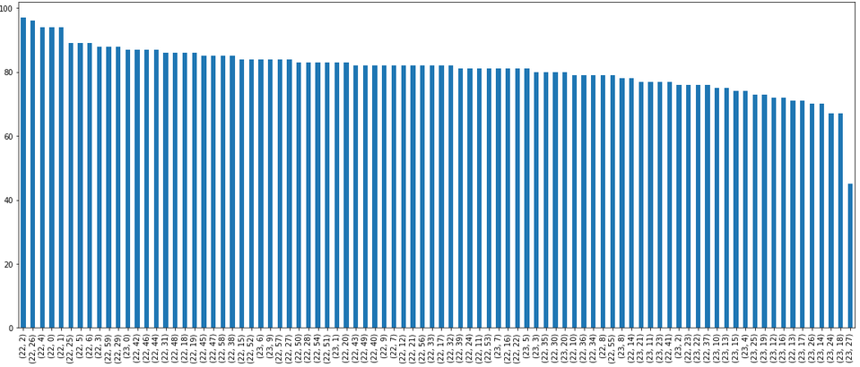
How?
Data needed to be sampled because of limited processing power
Opted for a time slice sampling approach by taking a 0.5% random sample of data from each minute.
Distribution Before vs After sampling
More uniform with a slight downward trend…

Slide 5
….data in summary
Sample is 7122 records
Application of parsing methods and subsequent analysis yield the following insights
Traffic volume has a slight downward trend as it gets later in the night.
Device information was sparsely populated, however available data seemed to suggest apple was the most popular brand

Slide 6
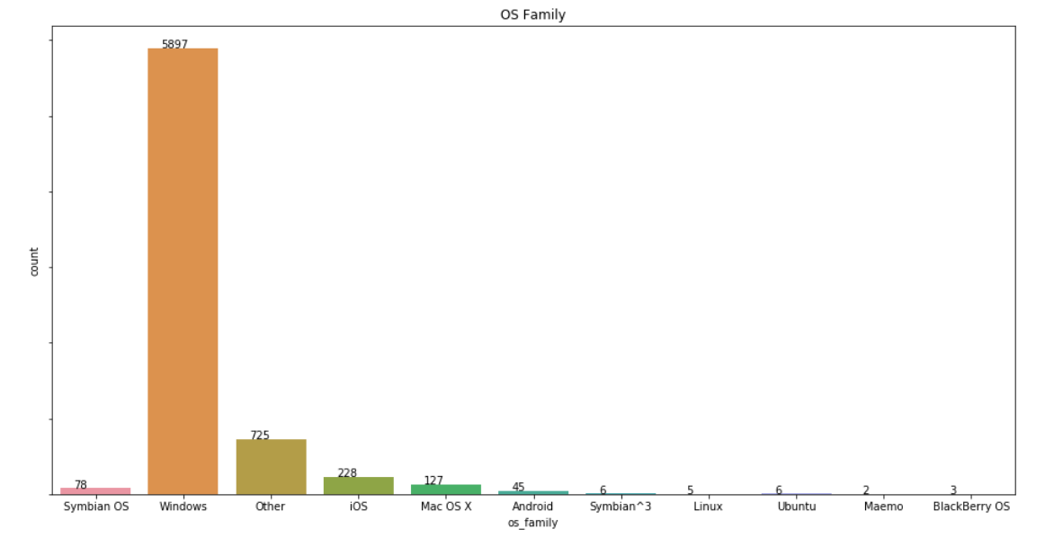
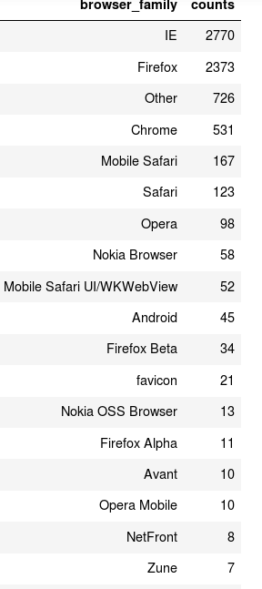
Top 3 identifiable browsers are IE, Firefox and chrome
83% of users use Windows
In general most of the traffic

Slide 7
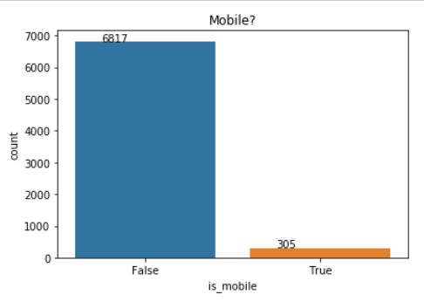
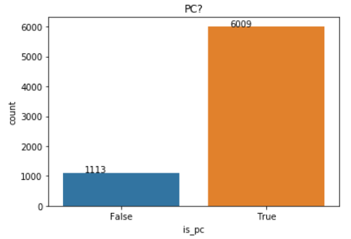
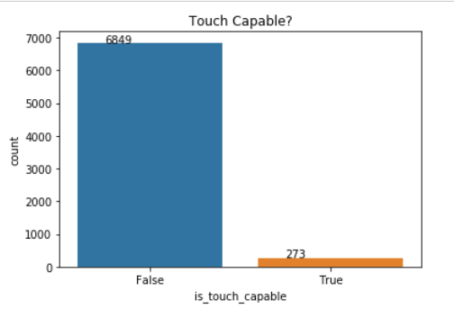
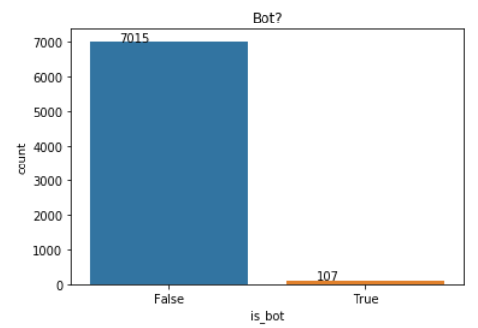
In general most traffic appeared to have been generated by PCs
not vey many bots…

Slide 8
How…The model
There were no continuous or ordinal features in the feature-set bar time. All features were categorical
Say if client was a pc or not, mobile or not, browser type etc.
Opted for a one class Support Vector Machine which is amenable to categorical features and is somewhat unsupervised in nature.
In all trained model was trained on 71 features
With a very low assumption of 0.5% anomalies in the sample

Slide 9
Outcome
Model identified 1.7% of the data as possible anomalies
It seemed to have isolated a lot of mobile traffic as outliers as there a characteristically a smaller set of the sample.
This could be a peculiarity with the usage habits of the population in question or down to accessibility.
Testing on the exploit folder the model identified 2.8% of cases as anomalies

Slide 10
API
Is flask application hosted on an aws ec2 instance at:
http://18.233.186.222:5000/
Use a web browser to assess a new user agent string just add it to the ua argument as such:
http://18.233.186.222:5000/api/user_agent?ua= <user agent string>
For example:
http://18.233.186.222:5000/api/user_agent?ua=[02/Aug/2011:22:03:40 -0700] "user_29" 0.0.0.0 0.0.0.0 9080 200 TCP_NC_MISS "GET http://www.thaitravelcenter.com/thailand/packages//thailand/include/read_currency.asp HTTP/1.0" "unknown" "low risk" "text/html" 531 799 "Mozilla/5.0 (Windows NT 6.1; rv:7.0a2) Gecko/20110801 Firefox/7.0a2" "www.thaitravelcenter.com" "-" "0" "" "-“

Slide 11
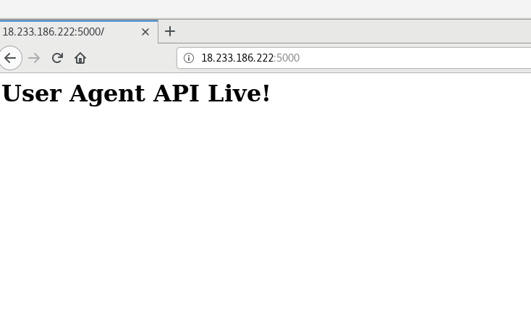
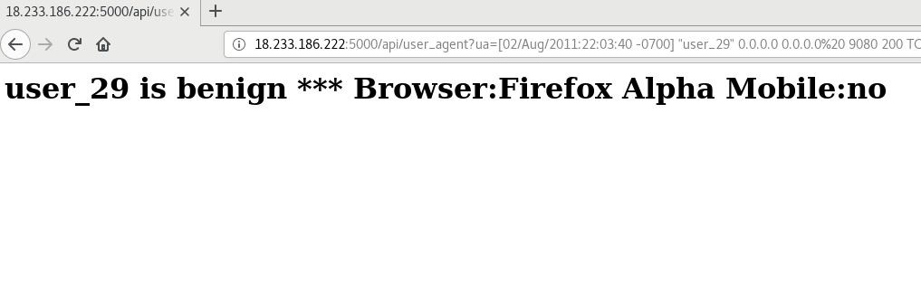
API…
Test page
New sample

